Slide 1
Faceless Self Portraits
March 2018

Slide 2
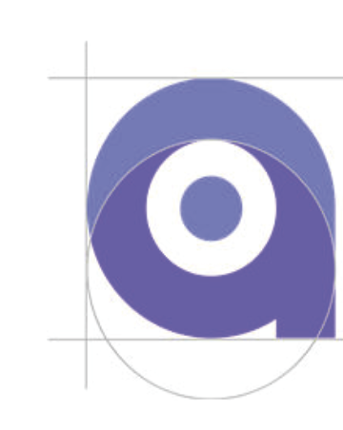
What is a Faceless Self Portrait?
A way to use a different perspective to explore and express your identity
Consider: How can you express your identity without your most identifying features?

Slide 3
How do I make one?
You will create a unique self portrait that does NOT include your face
You will use photos and text as references to draw an original composition that includes symbols, a theme, text and meaningful color

Slide 4
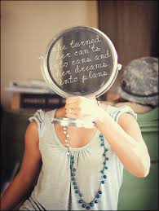
What could it look like?

Slide 5
What could it look like?

Slide 6
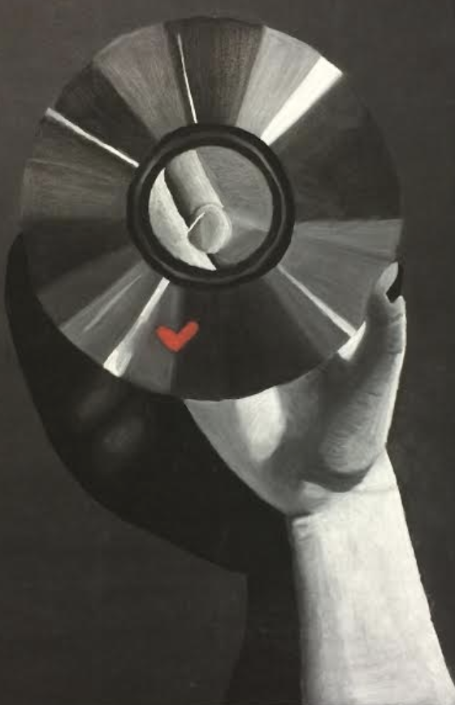
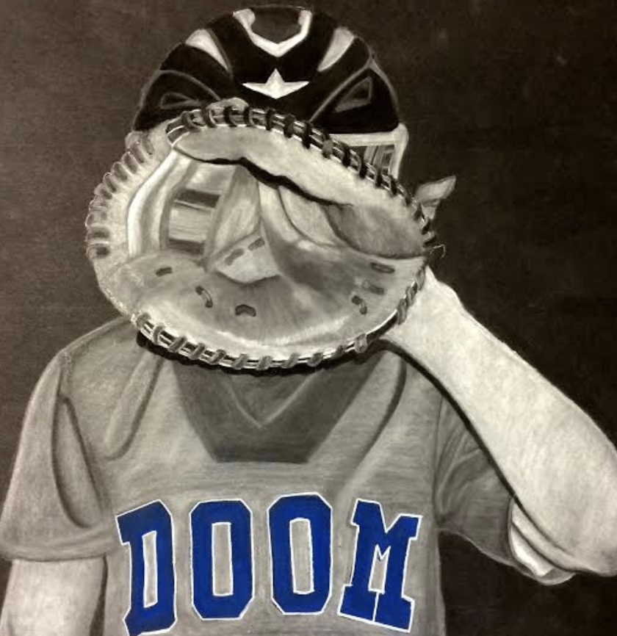
What could it look like?

Slide 7
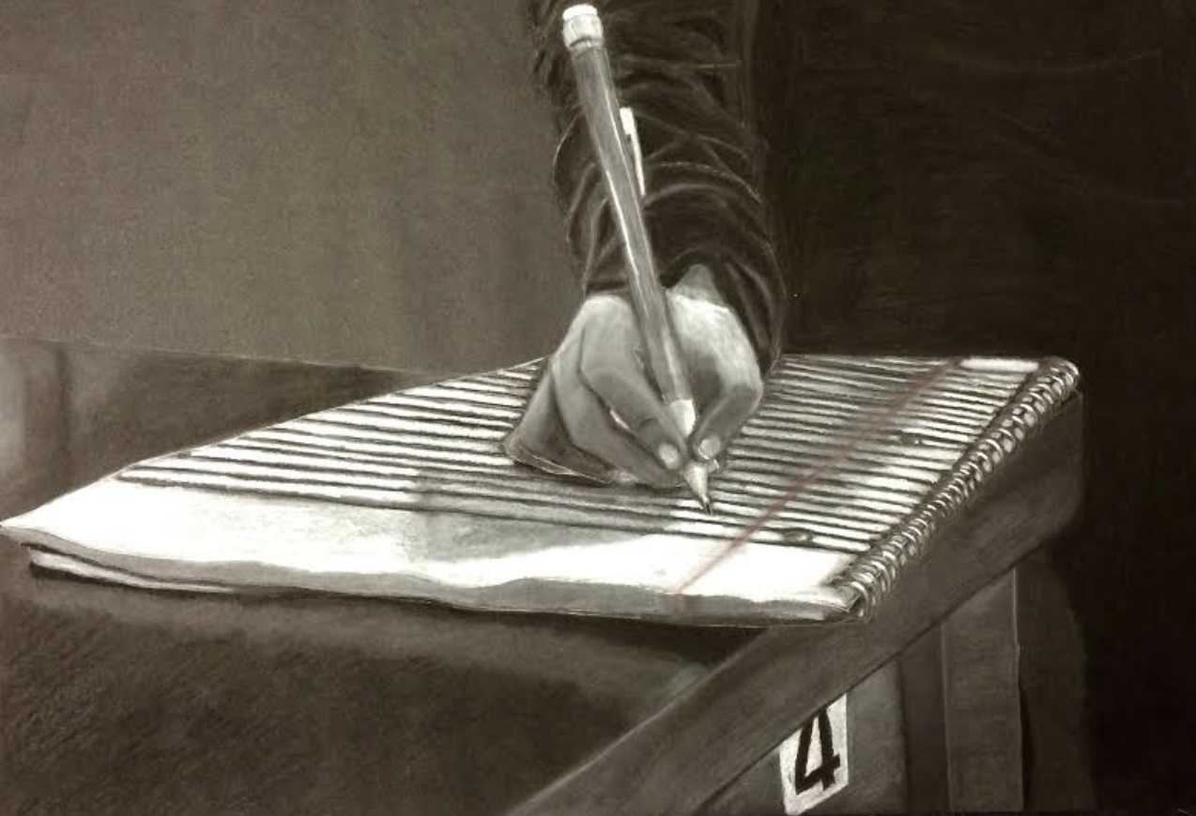
What could it look like?

Slide 8
What are the requirements?
3 symbols that create 1 theme
Text: at least one word
Color (intentional and meaningful)
Your original work
Completed written artist statement

Slide 9
What is a “good” composition?
Composition: how elements are organized within a work of art
It attracts the viewer’s eye and holds their attention
It conveys the mood (theme) you want it to
It tells a story

Slide 10
Principles of Design
Balance
Emphasis
Movement
Proportion
Rhythm
Unity
Variety
How elements are organized in a work of art

Slide 11
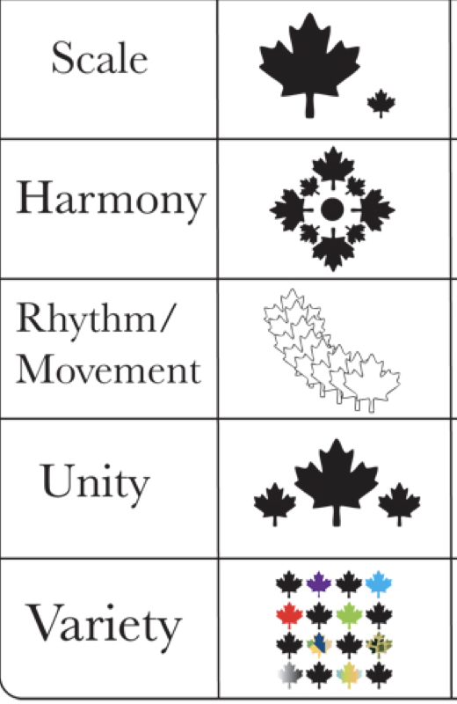

Slide 12
Relationships
It’s all about the relationships between shapes.
Motion
Depth
Size disparity
Focal point
Controlled viewer eye movement

Slide 13
Rule of Thirds
One element is more dominant than another (there is an imbalance)
Imbalances attract the viewer’s eye
Imbalance creates tension/weight (interest)

